Slide 1
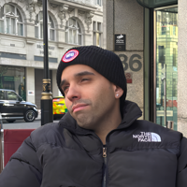
AI Meets SQL: Building a Smart Pizza Shop with .NET and Semantic Kernel
Emiliano Montesdeoca

Slide 2
SQL database + SEMANTIC KERNEL + NET + entityframework + whatever you want
Emiliano Montesdeoca

Slide 4
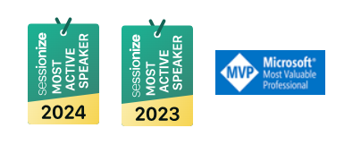

Emiliano Montesdeoca
Cloud Dev Team Lead @ Intelequia
MVP in Developer Technologies
@emimontesdeocaa

Slide 5
How do I make my dumb app smart?
Your boss every single day/week/month…
@emimontesdeocaa

Slide 6
How are our apps today?
Robotic interactions
Fixed code
No natural intelligence
Any change is complex
It costs money
@emimontesdeocaa

Slide 7
How should they apps be?
“Human” interactions
Personalized experience
Our data and our logic
Keeps improving
Easy to use
@emimontesdeocaa

Slide 8
Now, we are required to understand the application…
And it currently works!
@emimontesdeocaa

Slide 9
…but the applications of the future will understand us!
You can quote me on that!
@emimontesdeocaa

Slide 10

Semantic Kernel
AI for you made easy!
@emimontesdeocaa

Slide 11
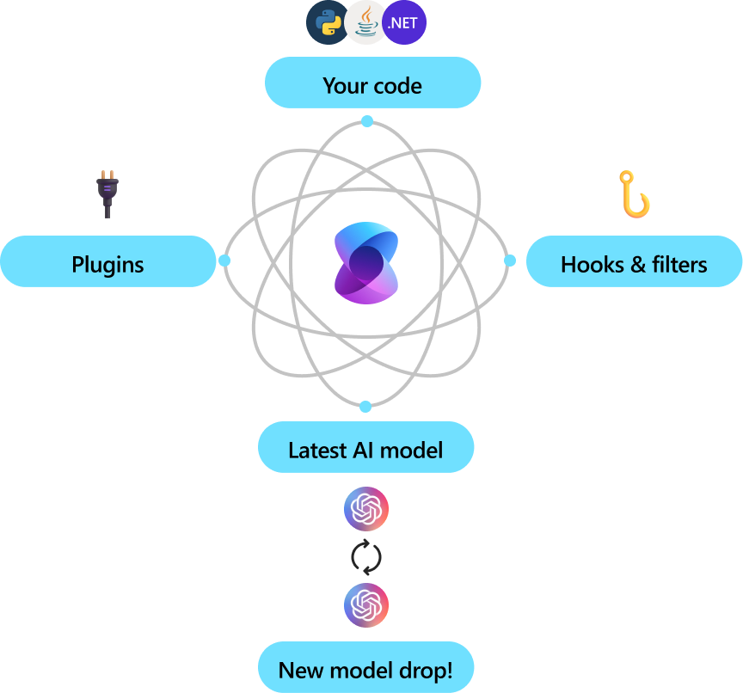
What is Semantic Kernel?
Semantic Kernel is a lightweight, open-source development kit that lets you easily build AI agents and integrate the latest AI models into your C#, Python, or Java codebase.
@emimontesdeocaa

Slide 12
Let’s do some code!
That’s why you’re here…. Right?
@emimontesdeocaa

Slide 13
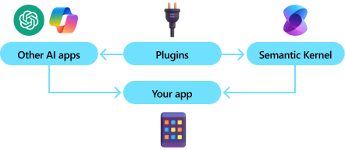
Kernel?
In its simplest form, the kernel is a dependency injection container that manages all the services and plug-ins required to run the AI application.
@emimontesdeocaa

Slide 14
If you provide all services and add-ons to the kernel, artificial intelligence will seamlessly use them as needed.
@emimontesdeocaa

Slide 15
More code!
Now let’s build good stuff!
@emimontesdeocaa

Slide 16
References, source code and useful links
emimontesdeoca/dday-sofia-2025-semantic-kernel-sql
microsoft/semantic-kernel: Integrate cutting-edge LLM technology quickly and easily into your apps
Introduction to Semantic Kernel | Microsoft Learn
emimontesdeoca (Emiliano Montesdeoca)
Emiliano Montesdeoca (@emimontesdeocaa) / X
@emimontesdeocaa

Slide 17
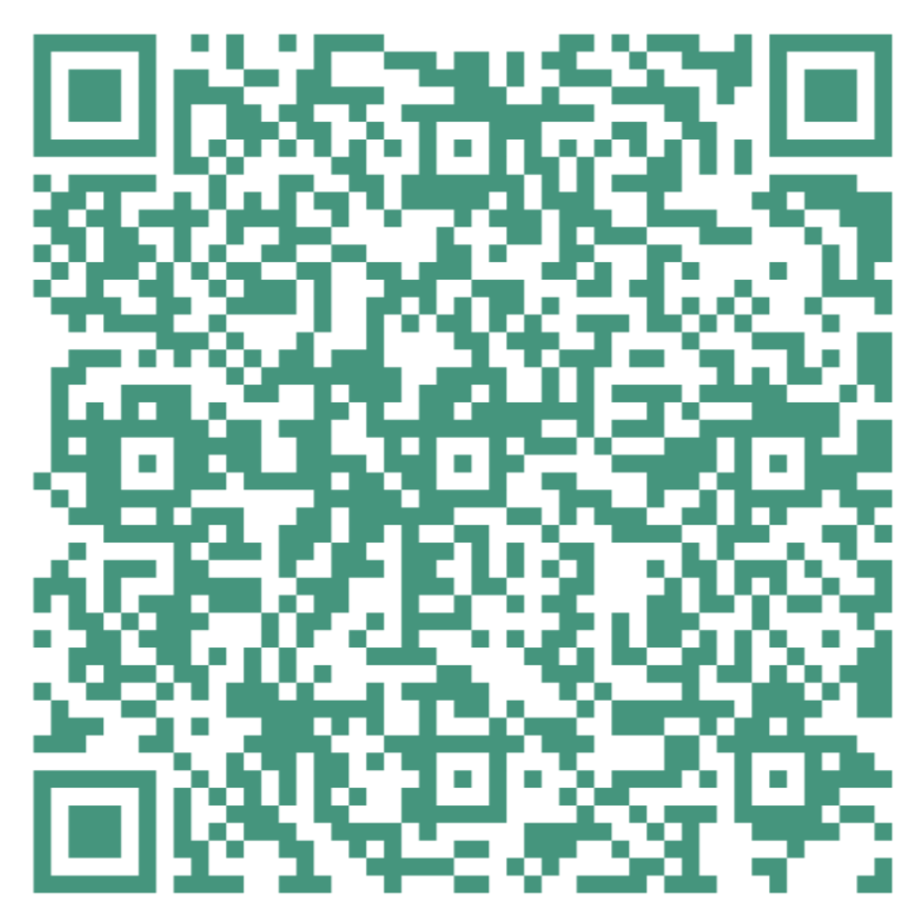
Feedback is always appreciated!

Slide 19
This slide is to be shown by Kamil Nowinski Only
SEE in notes!
Notes:
Instruction for Speaker: Kamil Nowinski Only
This slide is intended exclusively for Kamil Nowinski, following the session "Microsoft Fabric Real-Time Intelligence for Data Engineers."
After the session, there will be a coffee break (15:20 – 15:40) featuring gelato from our partner, Gelateria Diana. Please kindly:
Mention Gelateria Diana as our official partner for this refreshment.
Direct participants to the Coffee Break Zone
Thank you!

